Slide 1
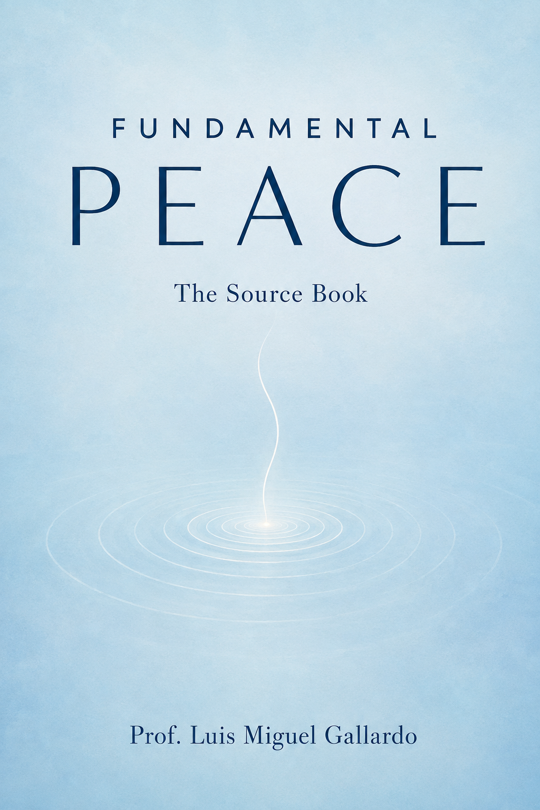
FUNDAMENTAL
PEACE
A visual companion to The Source Book
The idea, the measure, the way
Prof. Luis Miguel Gallardo
Notes:
Open with a few seconds of silence. Present the deck as a companion to the book: one idea, one measure, and one lived route. Source: Fundamental Peace: The Source Book, cover and pp. 5-20.

Slide 2

THE GROUND ROUTE
War closes the sky.
Peace goes by land.
A journey through conflict toward the peace that circumstance cannot take.
Fundamental Peace: The Source Book
02
Notes:
Tell the May 2025 journey in plain language. War closed the northern airports, so the author traveled by land toward Dharamshala. Use the road as the book's organizing metaphor. Source: pp. 6-9. Visual: original illustrative image generated for this presentation. It does not document the actual road or event.

Slide 3
The question beneath the book
What is the peace that survives the loss of everything peace agreements protect?
Vligna waited outside a school at four in the morning after war had taken her family and home. She still carried hope for peace and happiness.
The question is personal before it becomes political.
Fundamental Peace: The Source Book
03
Notes:
Introduce Vligna carefully as a witnessed person, not a symbol to be consumed. She had lost her children, home, and even her pets, yet waited before dawn to vote with hope for peace and happiness. End on the defining question. Source: pp. 12-13.

Slide 4
Three peaces, one foundation
POSITIVE PEACE
Justice is built into institutions and daily life
NEGATIVE PEACE
Direct violence stops
FUNDAMENTAL PEACE
The interior ground that can sustain both
Fundamental Peace sits beneath the other two. It does not replace them.
Fundamental Peace: The Source Book
04
Notes:
Credit Johan Galtung's distinction first. Negative peace concerns the absence of direct violence. Positive peace concerns the presence of justice. Fundamental Peace is proposed as the interior ground that helps sustain both. Source: pp. 80-82, Figure 14.

Slide 5
One peace, four registers
Not the absence of pain. The transmutation of its energy into love and compassion.
THE VOW
A bounded interior settling: deeply restful, fully alert, with agency intact.
THE SIGNATURE
A dynamic neuro-experiential state, characterized by four capacities.
THE MEASURE
A state to enter, a trait to build, a life to walk.
THE WAY
A vow to keep, a state to enter, a measure to take, a way to walk
Fundamental Peace: The Source Book
05
Notes:
Explain that the four registers answer different needs. The vow is moral. The signature is phenomenological. The measure is scientific. The way is practical and developmental. Keep the order intact. Source: pp. 83-86, Figure 16.

Slide 6

How peace feels from within
01
Flexible attentional control
Attention moves with ease, without forceful suppression.
02
Emotional coherence across self-states
Different feelings and parts remain connected.
03
Reduced self-referential rigidity
Thoughts can be observed without becoming identity.
04
Compassionate self-awareness
Experience is met with clarity and genuine kindness.
A dynamic capacity, not a moral rank
Fundamental Peace: The Source Book
06
Notes:
Give one ordinary example for each capacity. Stress that the construct describes integrated regulation under changing conditions. It does not equal sedation, dissociation, wellness branding, or moral superiority. Source: pp. 84-86 and 160-165. Visual: original illustrative portrait. It does not depict a person from the book.

Slide 7
The Peace Triad
FREEDOM
reduced self-referential rigidity
HAPPINESS
CONSCIOUSNESS
emotional coherence
flexible attentional control
COMPASSIONATE SELF-AWARENESS HOLDS THE THREE
Fundamental Peace: The Source Book
07
Notes:
Map freedom to reduced self-referential rigidity, consciousness to flexible attention, and happiness to emotional coherence. Compassionate self-awareness is the setting that holds the three stones together. Source: pp. 87-89, Figure 5.

Slide 8
Identity can be a window or a wall
COSMIC
The higher rung includes the lower one.
It does not erase it.
PLANETARY
UNION OF NATIONS
NATION
REGION
Threat hardens identity. Fulfilled identity can widen belonging.
CITY
HOUSEHOLD
SELF
Fundamental Peace: The Source Book
08
Notes:
Identity is not the enemy. Threat can rigidify it into a wall. Fulfillment can turn it into a window and widen belonging. Each higher rung includes the lower rung. Source: pp. 35-47, Figure 3.

Slide 9
The anatomy of a conflict
THE EMPTY CHAIR
neutrality and wisdom
THE PRESERVATIVE
rigid identity and manufactured memory
THE FIRE
fear and hate
THE PROFITEER
an industry that wins either way
THE ENGINE
power and domination
THE PRIZE
access to resources
The book maps both the outer machinery and the interior fuel.
Fundamental Peace: The Source Book
09
Notes:
Build the layers from resources upward. The book connects external incentives and institutions with fear, hatred, and rigid identity. The empty chair represents neutrality and wisdom, the capacity that can see the whole field. Source: pp. 41-47, Figure 15.

Slide 10
Peace requires a counter-curriculum
Hatred requires a curriculum. Peace requires permission.
GALLERY
SCHOOL
seen
cared for
THE PERSON
STORE
FRAMING
provided for
proud
Four rooms. Four nutrients. A field that teaches people what they can become.
Fundamental Peace: The Source Book
10
Notes:
Tell the formative story of the four rooms and four nutrients. Then connect it to peace education: hate requires deliberate manufacture, while peace needs permission, practice, collaboration, and repair. Source: pp. 21-34 and 48-58, Figures 2 and 4.

Slide 11
No map of light is complete without shadow
D1
INDIVIDUAL / PSYCHOLOGICAL
D2
RELATIONAL / SOCIAL
FPI = 100 - GPTM
D3
COLLECTIVE / CULTURAL
D4
STRUCTURAL / SYSTEMIC
Population-level estimate. Preliminary and heuristic.
D5
EXISTENTIAL / SPIRITUAL
D6
SOMATIC / BIOLOGICAL
D7
ENVIRONMENTAL / PLANETARY
Fundamental Peace: The Source Book
11
Notes:
Sweep from individual pain to planetary suffering. Explain that FP20 directly measures a person's reported state, while GPTM and its inverse FPI estimate population conditions through the shadow. Label FPI as preliminary and heuristic. Source: pp. 93-101, Figure 6.

Slide 12
Three bodies of testimony
Independent sources converge on compatible capacities while their doctrines remain distinct.
C1
C2
C3
C4
TRADITIONS
A map of invitations, never of equivalences
LIVING LEADERS
DEEP-STATE REPORTS
-
The scale measures the footprint, not the thing.
Fundamental Peace: The Source Book
12
Notes:
The three bodies are traditions, living leaders, and reports from deep-state sessions. The claim is convergence of described capacities, not proof that doctrines are identical or that any metaphysical account is true. Source: pp. 102-151, especially Figure 7. The deep-state source remains epistemically unknown.

Slide 13
The profile matters more than the total
20
4
3-5
STATEMENTS
COMPONENTS
MINUTES
PROFILE A
PROFILE B
C1
C1
C1 Flexible attentional control
C4
C2
C2 Emotional coherence across self-states
C4
C2
C3 Reduced self-referential rigidity
C4 Compassionate self-awareness
C3
C3
TOTAL 12
TOTAL 12
Same number. Different practice.
Fundamental Peace: The Source Book
13
Notes:
Introduce FP20 as twenty self-report statements across four components, completed in three to five minutes. Compare the two profiles. The same total can require different practices. Always report the profile with the total. Source: pp. 160-169 and 286-290, Figure 8.

Slide 14
Rigor makes the limits visible
ESTABLISHED
The construct is defined. A bilingual 20-item instrument exists.
UNDER INVESTIGATION
Reliability, validity, change over time, and use across settings.
UNPROVEN
Population inference and durable transmission between people.
No diagnosis. No ranking. No hiring, promotion, certification, or external reward.
Fundamental Peace: The Source Book
14
Notes:
Separate what is established, being tested, and still unproven. Read the guardrail aloud. FP20 measures a fluctuating state, not a person. It can never gate hiring, promotion, ranking, certification, or reward. Organizations see aggregates only. Source: pp. 153-178 and p. 2, Figure 19.

Slide 15
Why glimpses fade
A GLIMPSE
STATE WITHOUT PRACTICE
MATERIAL UNTRANSMUTED
THE OLD FIELD
A moment does not yet have a daily structure.
Old protection returns when pressure rises.
Life still rewards the earlier version of the person.
The method addresses practice, material, and environment.
Fundamental Peace: The Source Book
15
Notes:
Ask the audience to remember a genuine glimpse of inner settling. The book identifies three seams: practice, untransmuted material, and a life still organized by the former pattern. Source: pp. 187-194.

Slide 16
From automatic pattern to service
1
2
3
4
5
Unconscious
reactivity
Conscious
recognition
Gift
discovery
Essence
embodiment
Transcendent
integration
Development is domain-specific and uneven. The model never ranks people.
Fundamental Peace: The Source Book
16
Notes:
Walk through the Integrative Transformation Model. Development differs by domain and can move backward under pressure. Never use the model to rank a human being. Source: pp. 187-193, Figure 9.

Slide 17
The Ground Route
1
GROUND
2
SETTLE
3
FOCUS
4
INTEND
ethics and relationship
body and breath
one anchor
a compassionate direction
8
RETURN
7
CHOOSE
6
TRANSMUTE
5
WITNESS
spend it in life
act in the interval
protection into gift
experience without fusion
DAILY ENGINE Settle, Focus, Intend, Witness, Choose
Standing ethic: peace is not measured by compliance.
Fundamental Peace: The Source Book
17
Notes:
Reveal all eight movements. Ground begins with ethics and relationship. Return ends in service. The daily engine uses movements two through five plus Choose: Settle, Focus, Intend, Witness, Choose. Source: pp. 195-231 and 291-292, Figure 10.

Slide 18
Five minutes of practice
01
SETTLE
Let the exhale lengthen. Let the chair hold your weight.
5:00
02
FOCUS
Choose one anchor. Return when attention wanders.
03
INTEND
Name one simple, compassionate direction.
04
WITNESS
Notice thought, feeling, and story as events.
05
CHOOSE
Ask what the settled version of you does here.
Eyes open or closed. Participation is optional. Stop at any time.
Fundamental Peace: The Source Book
18
Notes:
Guide a 90-second version or allow a full five minutes. Keep agency explicit. Participants may keep eyes open, may pass, and may stop. Use a neutral anchor and do not invite trauma disclosure. Source: pp. 202-208 and 291-292.

Slide 19
Pain takes one of two routes
TRANSMITTED
TRANSMUTED
REPRESSION
EXPRESSION
DENIAL
HONESTY
SHAME
DIGNITY
REJECTION
BELONGING
GUILT
FORGIVENESS
SEPARATION
COMMUNION
The virtue is the wound at another frequency. Harm is never romanticized.
Fundamental Peace: The Source Book
19
Notes:
Explain Shadow-Gift-Essence as one energy at different frequencies. Walk through the six wound and virtue pairs. The framework does not justify harm or turn wounds into personality types. Source: pp. 209-216, Figure 11.

Slide 20
The five-step alchemy
1
ARRIVE
in the body
5
FIND THE GIFT
2
LOCATE
give it one action today
sensation, not story
SHADOW
↓
GIFT
4
ASK
3
WELCOME
what it protects
let it be here
Deep or traumatic material needs a qualified companion.
Fundamental Peace: The Source Book
20
Notes:
Use a mild example only. Locate sensation rather than rehearsing story, welcome the protection, ask what it protects, then turn the discovered capacity into action. Deep material belongs with qualified support. Source: pp. 217-225, Figure 12.

Slide 21

Choose. Return. Spend the peace.
Peace becomes real when another person receives it.
The settled state crosses the interval into one small action, then returns to the household and the wider field.
Fundamental Peace: The Source Book
21
Notes:
Move from inner interval to lived relationship. The question is: what does the settled version of me do here? Choose something small, then let another person receive it. Source: pp. 226-241. Visual: original illustrative image generated for this presentation. It is not a documentary scene from the book.

Slide 22
The scales of return
The same eight movements, at widening radius
Repair at the table. Structural change at work. Civic places for encounter. Regulated rooms between nations.
HOUSEHOLD
ORGANIZATION
CITY
AMONG NATIONS
TEN BILLION
Fundamental Peace: The Source Book
22
Notes:
Explain the widening rings. The household practices reliable repair. Organizations change structure and can use the 6 Rs. Cities build places of encounter. Diplomacy adds a shared anchor, corrected measure, and regulated room. Source: pp. 233-264, Figures 21 and 22.

Slide 23
A dream with a denominator
25 million
400 lives
10 billion
×
=
CATALYSTS
IN A WORKING LIFE
PEOPLE
This arithmetic demonstrates plausibility, not inevitability.
The strained join: does a changed interior create durable change in another person's field?
Fundamental Peace: The Source Book
23
Notes:
Present the equation as a denominator for a dream, not as a forecast. Twenty-five million catalysts touching four hundred lives each reaches ten billion arithmetically. The transmission link remains an urgent unproven research question. Source: pp. 265-273, Figure 13.

Slide 24

GENERATION TXAI
Txai means 'my other self' in the Huni Kuin tradition.
Who receives something different from you in the next seven days?
One breath. One ordinary action. Begin there.
Prof. Luis Miguel Gallardo
Fundamental Peace: The Source Book
24
Notes:
Attribute Txai to the Huni Kuin and translate it as 'my other self.' Invite each person to name one human being who will receive something different within seven days. Close with one breath and the next ordinary action. Source: pp. 265-276. Visual: original illustrative image generated for this presentation.

